Slide 1

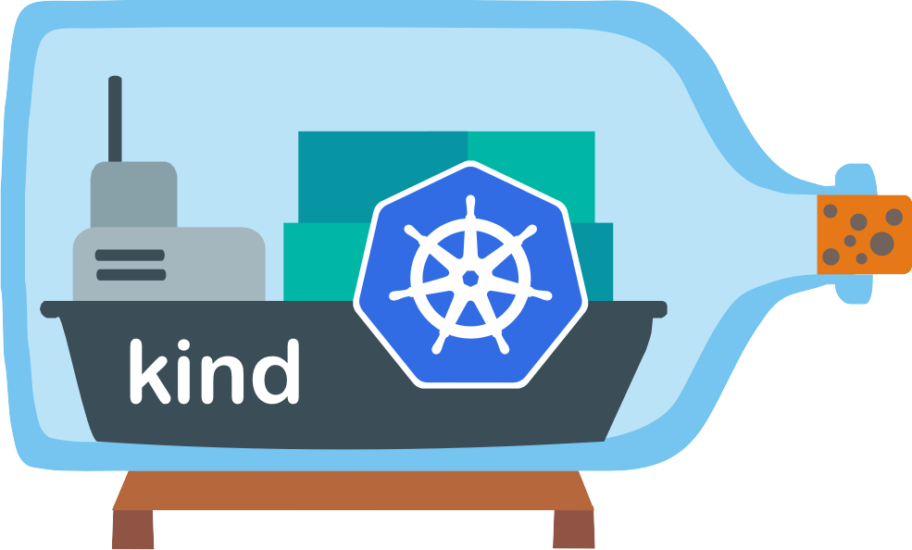
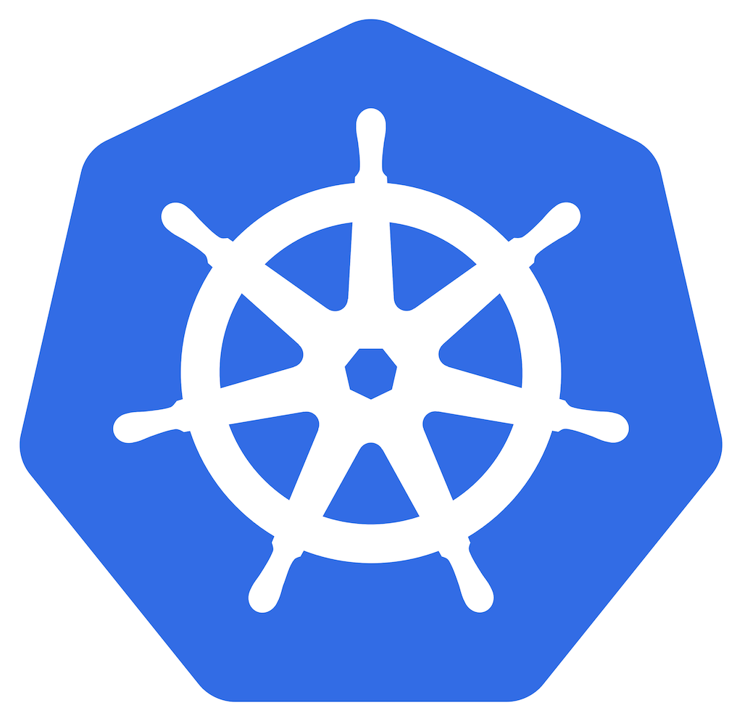
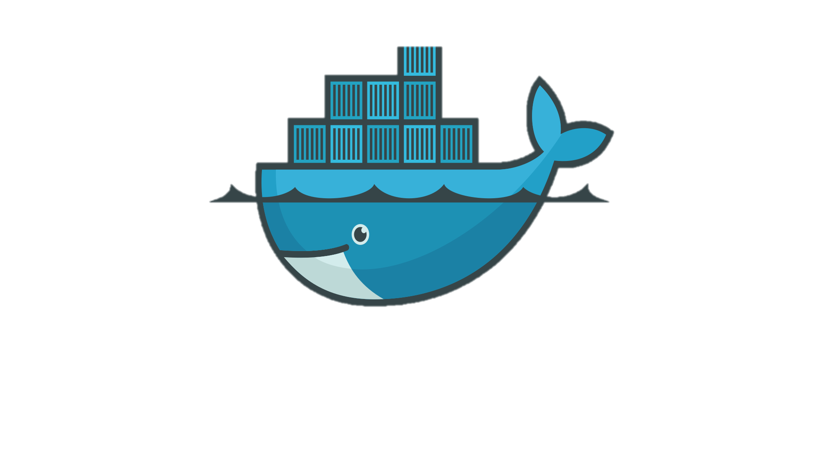

TANZU SHARING
Notes:
Welcome everyone to this sharing on Tanzu!!
Before we get started, I would like to thank everyone for taking the time to attend this session, which I hope will be a fruitful one.
So, without further ado, let’s get started!

Slide 2
Hello Everyone!
I AM RYAN
Explored Tanzu Community Edition
Deployed Applications
Notes:
Just a brief introduction of myself, I am Ryan, an intern under Luke, and I have done my exploration on the different functionalities of Tanzu, SPECIFICALLY, ITS COMMUNITY EDITION. In fact, I have used it to deploy certain applications, and would now like to share what I have learned so far.
With this, let’s proceed!

Slide 3
1
TABLE OF CONTENTS
Let’s start with an overview of this sharing
Notes:
Before diving right in, let’s take a look at what are the CONTENTS that will be covered in this sharing.

Slide 4



Tanzu Community Edition
01
What it is
Who is it for
Benefits
Unmanaged Cluster
02
Overview
KinD
Comparing with Managed Cluster
Managed Cluster
03
Overview
Bootstrapping
CAPI
Notes:
So, we will start off with knowing what Tanzu Community Edition really is, and after which, we will touch on UNMANAGED and MANAGED CLUSTERS, where we will understand topics like KinD, Boostrapping, and CAPI.

Slide 5



Demonstration
04
Scenario
Setup
Recap
Package Management
05
Package Repository
Downloading Packages
Demonstration
Conclusion
06
Recap
Troublshooting
Summary
Notes:
Next, we will look at some demonstrations, and also talk about the Package Management System. Finally, we will have our conclusion.
WOO! We have quite a fair bit to cover, so let’s get started, STARTING withhhhh…

Slide 6
2 TANZU COMMUNITY EDITION
Let’s explore TCE!
Notes:
…Understanding what Tanzu Community Edition really is

Slide 7




What It Is
Only ONE management cluster can be spawned per setup
Simple Command Line Interface
Kubernetes-Friendly Installer
Without Services Like Tanzu Mission Control and Tanzu Observability
Free and Open-Source
Tanzu Community Edition
Limitation
Learning Platform
Notes:
It is a free and open-source distribution of VMware Tanzu. So, you can install it onto your local machine for ABSOLUTELY no cost.
Also, besides being free, it is also a great LEARNING PLATFORM for anyone who is keen on learning Kubernetes as it can be easily installed, and has a simple command line interface.
However, while all these are great, we should remember that this is NOT the Enterprise edition of Tanzu, and so certain SERVICES, like Tanzu Mission Control, will NOT be available. And for those who already have experience in the enterprise edition, this version only supports one management cluster per setup. So we have to keep this in mind.
Alright, moving on!

Slide 8



Kubernetes
Automate:
Configuration
Provisioning
Scaling
Health Monitoring
Artifact
Containerized Applications
App
Container Orchestration Tool
App
App
App
Pod
Pod
Docker
Pod
Pod
Host Operating System
Infrastructure
Node
Node
Notes:
Now, it is important that we first understand the concept of Kubernetes as it forms the VERY BASIS of Tanzu Community Edition.
I’m sure most of us know what CONTAINERS are. If not, essentially, they are built using CONTAINER ENGINES, like Docker, and they CONTAIN our applications, or artifacts, and are lightweight and portable enough that they can run on ANY Operating System.
On the other hand, Kubernetes, a CONTAINER OCHESTRATION TOOL, takes this a step further. It manages the LIFE CYCLE of containers as it AUTOMATES the Configuration, Provisioning, Scaling and Health Monitoring of them. It MAINLY consists of NODES, and in them are PODS, in which our containers will run, and all of these components make up a CLUSTER.
With this, we can move on!

Slide 9

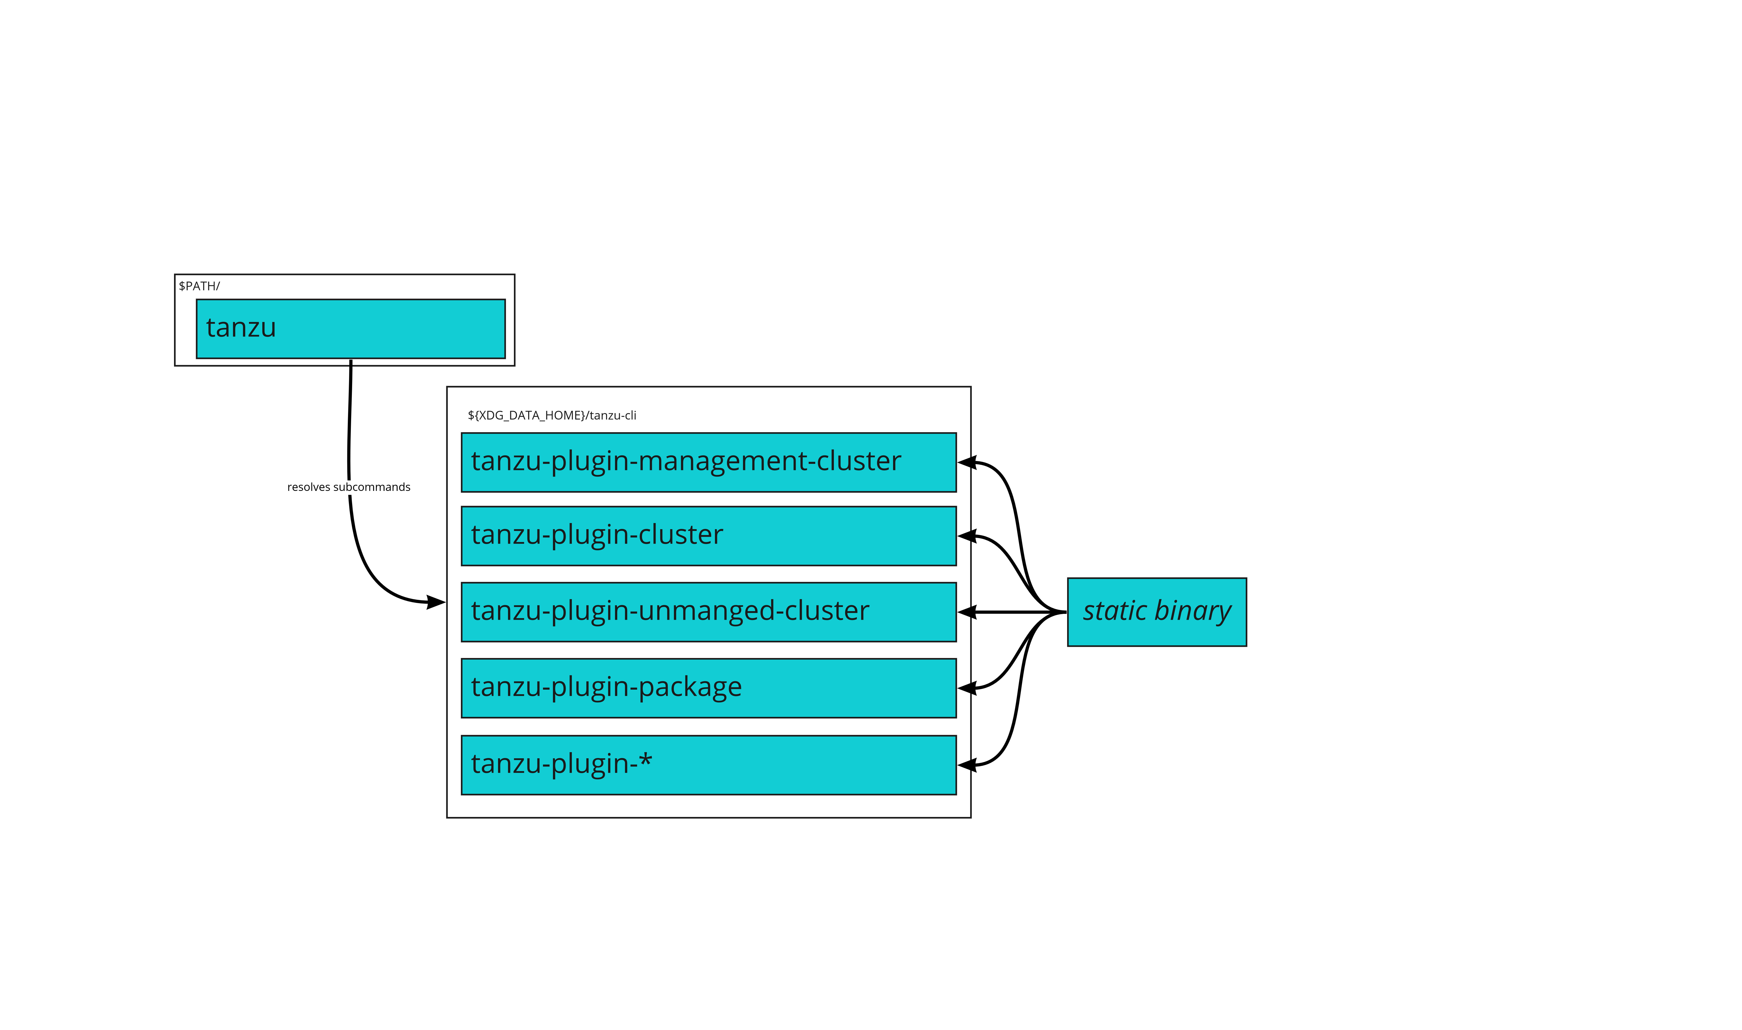


Tanzu Community Edition Overview
Unmanaged Cluster
Managed Cluster
Tanzu Package Management
Notes:
Now, back to the topic of Tanzu Community Edition, or TCE in short. Here’s just a quick overview of its architecture.
Fundamentally, TCE can be broken down into 3 components, namely, UNMANAGED CLUSTER, MANAGED CLUSTER, AND its PACKAGE MANAGEMENT, which we will touch on all of them, starting withhhh…..

Slide 10
3 UNMANAGED CLUSTER
Let’s explore what an unmanaged cluster is
Notes:
…An UNMANAGED CLUSTER

Slide 11
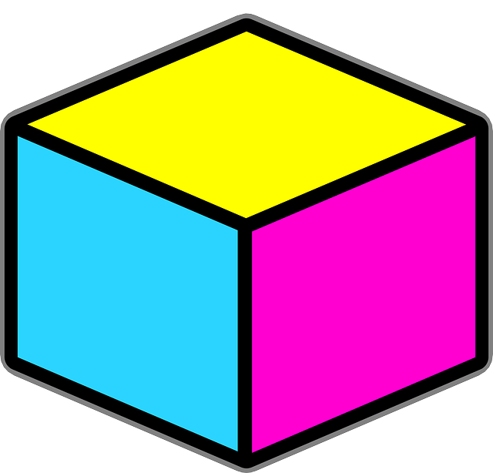
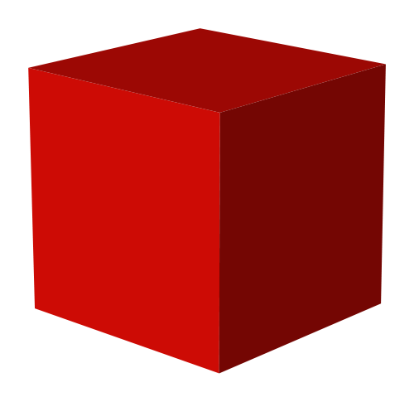
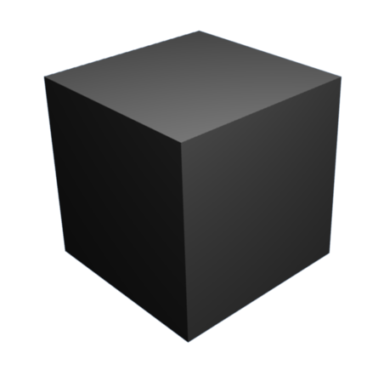

Unmanaged Cluster
WHAT IF WE WANT A KUBERNETES CLUSTER THAT CAN TAKE CARE OF DEPLOYING, SCALING, AND LIFE CYCLE MANAGEMENT OF OTHER CLUSTERS?
Lacking:
Key Features:
Only Able to Run on Your Local Workstation (single infrastructure node)
Adding more Instances of CP and (Worker) Nodes Only Adds more Containers to the Main/Root Container → Unable to Attain True Scaling or High Availability
Unable to Spin Up Clusters
Plain (Kind) Kubernetes Cluster
Cluster is a Container, and within it are the Control Plane (CP) and Node Containers
Fast Start-Up and Tear Down since Cluster is Just a Single Container
Good for Testing Purposes
MAIN
Control Plane
Node
Pod
Notes:
In essence, a TCE UNMANAGED CLUSTER, is a simple Kubernetes cluster that has a CONTROL PLANE and a WORKER NODE. These nodes, and IN FACT the cluster itself, are CONTAINERS since this cluster is built using KIND, or “Kubernetes in Docker”. And since this cluster can be treated as just one big container, it can be easily started up and torn down. One big ADVANTAGE of using an unmanaged cluster is that it is good for TESTING PURPOSES. So, for instance, you can test IF your application is deployable with this cluster.
HOWEVER, with that said, it LACKS many features. For example, it can ONLY run on your local workstation and nowhere else, which means it does not have TRUE SCALING, or HIGH AVAILABILITY, since any ADDITION of control plane, or worker nodes, is only done WITHIN the main CLUSTER CONTAINER itself. Furthermore, it is unable to SPIN UP clusters other than itself.
So, [READ FROM SLIDE]

Slide 12
4 MANAGED CLUSTER
Let’s explore what a managed cluster is
Notes:
Look no further, we have TCE MANAGED CLUSTER!

Slide 13




Managed Cluster
Management Cluster
Control Plane
Node
Node
Node
CP
Node
CP
CP
Pod
Pod
Pod
User
Workload Clusters
Notes:
So here, we have what looks like an unmanaged cluster, with a control plane and worker node. BUT, it is not! It is, in fact, a MANAGEMENT CLUSTER. Why? Because it is able to DEPLOY, SCALE and handle LIFE-CYCLE MANAGEMENT of OTHER clusters, also known as WORKLOAD CLUSTERS. And it is in these workload clusters that our applications are running. GREAT! It solves the problems that an unmanaged cluster faces.
Before discussing more about workload clusters, we have to know how the management cluster is created in the first place!

Slide 14
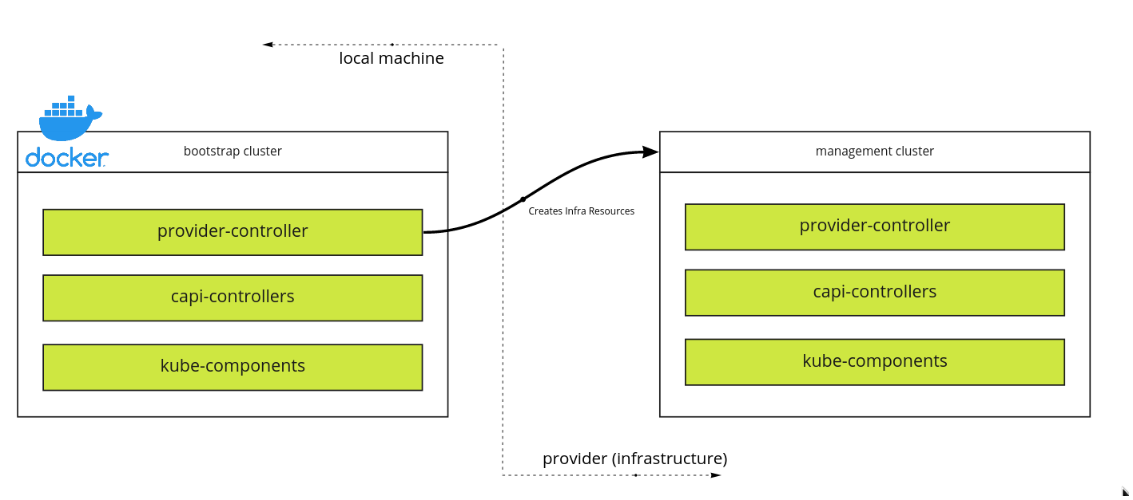
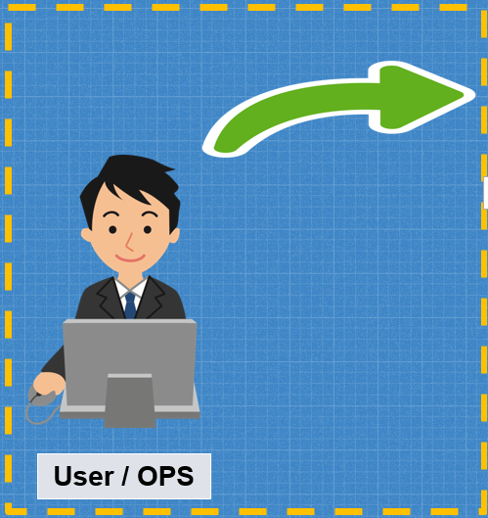
Notes:
To create a management cluster, TCE utilizes the concept of BOOTSTRAPPING!
In short, a bootstrap cluster will first be created TOGETHER with the necessary infrastructure resources before creating an actual management cluster, where it will then move, or PIVOT, the infra resources to. Once all the resources have been moved, the management cluster can now operate as how it should be. As simple as that!
Now, to understand how the management cluster is able to spin up WORKLOAD clusters very easily, we have to look into the CAPI, or Cluster API, resource within it.

Slide 15
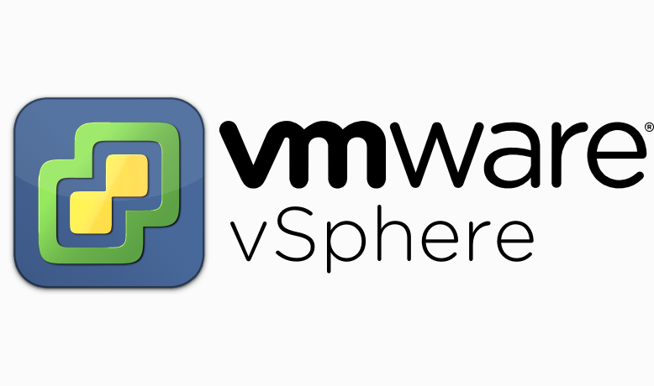





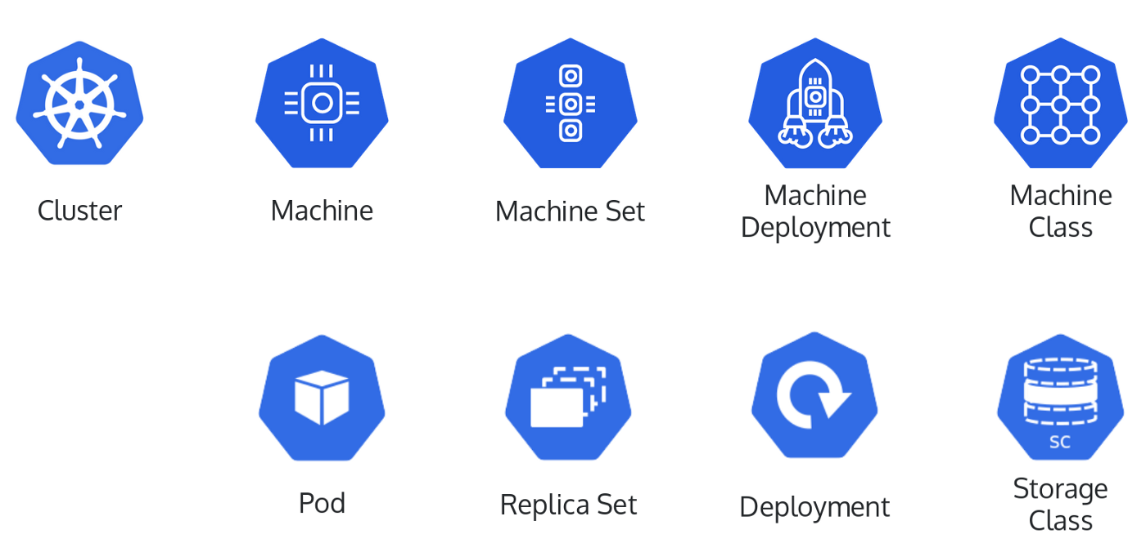
YAML
User
Declarative Configuration
Declarative, Kubernetes-Style API
Compatible with Command Line Tool kubectl
Provides a Consistent Way to Provision and Manage k8s Clusters across Cloud Providers
Cluster API
CRDs
Notes:
Cluster API, or CAPI, is a […]
Let’s understand the concept of CAPI visually.
So first and foremost, a user has to create a YAML CONFIGURATION FILE, and it has to be of a DECLARATIVE nature. Now, with this file, he can run the TANZU COMMAND LINE INTERFACE, OR CLI, which will TRIGGER the CAPI, and the CAPI will then AUTOMATICALLY create the resource, in this case, a WORKLOAD cluster, on any of the cloud providers that the user has specified BECAUSE it already has Custom Resource Definitions (CRDs), like cluster and machine deployment, built in it on top of the usual Kubernetes API resource definitions, like DEPLOYMENT.
So, with how the CAPI is designed, we can see why the MANAGEMENT CLUSTER is able to spin up workload clusters that easily and quickly! An AMAZING feature of TCE indeed!

Slide 16
Management Cluster
Control Plane
Node
The Management Cluster is a Central Management Location!
Node
Node
CP
Node
CP
CP
Pod
Pod
Pod
User
Workload Clusters
Notes:
Now that we have understood how a management cluster is created, and MORE importantly, how it operates with the CAPI resource in it, we can CONCLUDE that the management cluster is, in fact, a CENTRAL MANAGEMENT LOCATION for any QUERYING and CONFIGURATION of workload clusters. NICE!!

Slide 17
5 DEMONSTRATION
Let’s go over an example to see how all these work in practice
Notes:
Now, we will be going over a demonstration to see all of what we have learned in practice.

Slide 18
SCENARIO
We intend to deploy a web application that has….
UI Module
Main Module
Model Module (Disinformation Detection)
Database (MongoDB)
Notes:
For our demonstration, we will DEPLOY a web application, which is a working prototype but in the production stage, that has UI, Main, Model, and Database, or MongoDB, modules using Tanzu Community Edition.

Slide 19





CLUSTER
NODE
DEPLOYMENT (UI)
DEPLOYMENT (MAIN)
DEPLOYMENT (MODEL)
STATEFULSET (MONGO)
POD
POD
POD
POD
SETUP
Containerized App
Containerized App
Containerized App
Containerized App
Notes:
Now, for our setup, we will first create a WORKLOAD CLUSTER with one WORKER NODE, after which, we will create DEPLOYMENT RESOURCES for our UI, Main and Model Modules, and a STATEFULSET RESOURCE for MongoDB. And in THESE resources, OR the worker node, we will have our PODS containing our CONTAINERIZED applications.
Alright! Before we can proceed with this setup, REMEMBER…….

Slide 20

IT ALL STARTS WITH CREATING A MANAGEMENT CLUSTER!!
LET’S PROCEED WITH THE DEMONSTRATIONS!!!
Notes:
It all starts with creating a MANAGEMENT cluster!!!
With that in mind, let’s go over the demonstrations!

Slide 21
Provisioning Management Cluster
Notes:
So here is the provisioning of a management cluster

Slide 22
Provisioning Workload Cluster
Notes:
Now, for our workload cluster

Slide 23
Provisioning Cluster Resources
Notes:
Now to provision our cluster resources

Slide 24

Useful Commands:
tanzu management-cluster create --ui
tanzu management-cluster get
tanzu management-cluster kubeconfig get <MGMT-CLUSTER-NAME> --admin
kubectl config use-context <MGMT-CLUSTER-NAME>-admin@<MGMT-CLUSTER-NAME>
kubectl get nodes (-o wide => displays nodes in greater detail)
kubectl config view
tanzu cluster create <WORKLOAD-CLUSTER-NAME> --plan dev
tanzu cluster list
tanzu cluster kubeconfig get <WORKLOAD-CLUSTER-NAME> --admin
docker ps
kubectl apply –f <FILEPATH>
Notes:
Just a recap, here are the commands that I have run in the demonstrations. For example, tanzu management-cluster create –ui and kubectl config view.
Great! Moving on!

Slide 25
6 PACKAGE MANAGEMENT
Let’s explore Tanzu Package Management and see it in practice
Notes:
Now, besides providing us with managed clusters, TCE too has its PACKAGE MANAGEMENT that we can take advantage of!

Slide 26
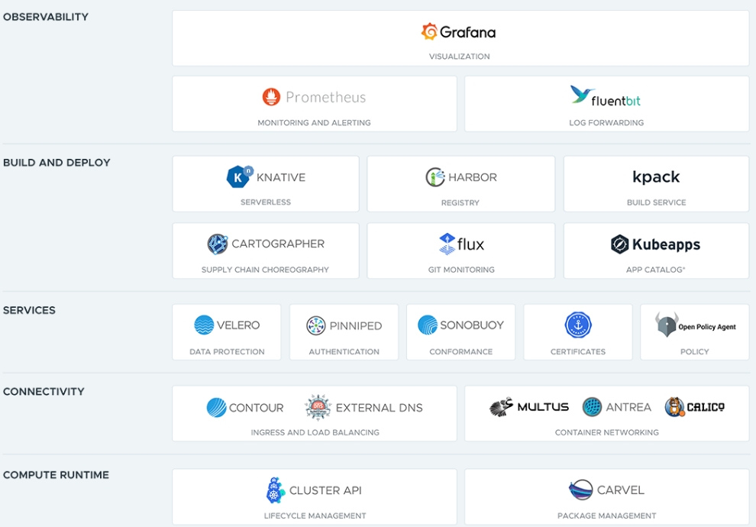
Notes:
Look! There are many packages provided by TCE that are useful in buffing up your clusters. For instance, we have Grafana, Harbor, Contour and the list goes on! In the following slide, we will see a demonstration of the installation of a package.

Slide 27
Implementing Package Repository

Slide 28
7 CONCLUSION
Let’s wrap things up!
Notes:
ALRIGHTT! So finally! We have come to the conclusion section, and in the following slide we will do a recap on our web application demonstration

Slide 29
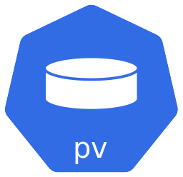

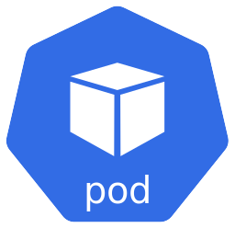

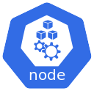
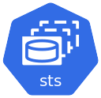
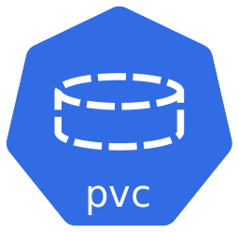

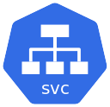
RECAP
Workload Cluster
Persistent Volume
Pod
Storage Class
Deployment
StatefulSet
Persistent Volume Claim
Service
Notes:
So after creating our management cluster, and spinning up a workload cluster, we first have our worker node, and in it we have our deployments, services, a statefulset, and pods. Now, using the local-path-storage package that we have downloaded from tanzu package repository, we got ourselves a Storage Class, which our mongoDB module will use for persistent volume. And of course, we have also created a secret resource where our private dockerhub repository credentials will be stored in.
Awesome!

Slide 30
Other Useful Commands:
tanzu cluster scale <CLUSTER-NAME> --controlplane-machine-count { } --worker-machine-count { } --namespace <NAMESPACE>
docker exec –it <NODE NAME> bash
kubectl exec –it <POD NAME> bash
kubectl logs <POD NAME>
kubectl describe pod <POD NAME>
kubectl get endpoints <SVC NAME>
kubectl get pod <POD NAME> -o yaml
kubectl delete pod/svc/deploy <NAME OF RESOURCE>
Notes:
Anyway, here are more commands that are useful. Pay attention to the two commands highlighted in red as they are very important when troubleshooting issues that you may encounter when deploying your applications. For SCALING of nodes, you can run the first command at the top.

Slide 31
CONCLUSION
Tanzu Community Edition (TCE)
Overview of TCE Unmanaged Cluster
Overview of TCE Managed Cluster
Understand how a Management Cluster is
Created
Cluster API
Overall Setup of our Web Application
Demonstrations
Useful Commands
Recap on the Workflow
Notes:
Now, looking back at what we have covered, we have discussed about […READ FROM SLIDE…]
Ok! We have come to the end of this sharing, I would like to thank everyone for tieing through this session, I know it’s a little long, but nevertheless, THANK YOU!

